Slide 1
WAITERLESS RESTAURANT SYSTEM
By: Ajay Pratap Singh
Roll No:16001001002
Batch:CSE 3rd Year

Slide 2
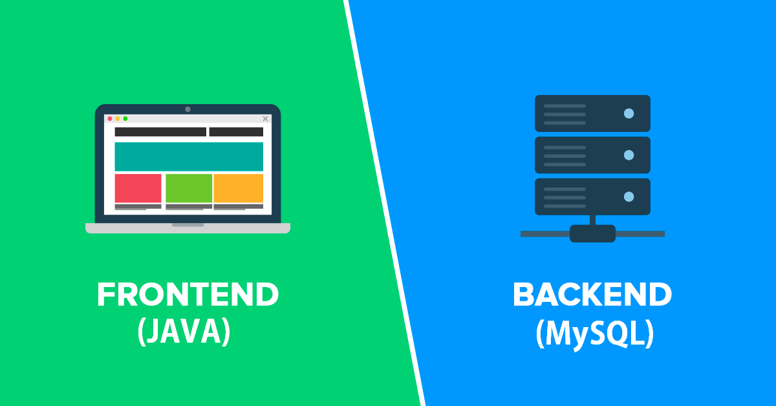
What I Used?

Slide 3
Devices :
1. A Local Server
2. A Computer for Manager
3. A Device on each Table
4. A Device in the Kitchen

Slide 4
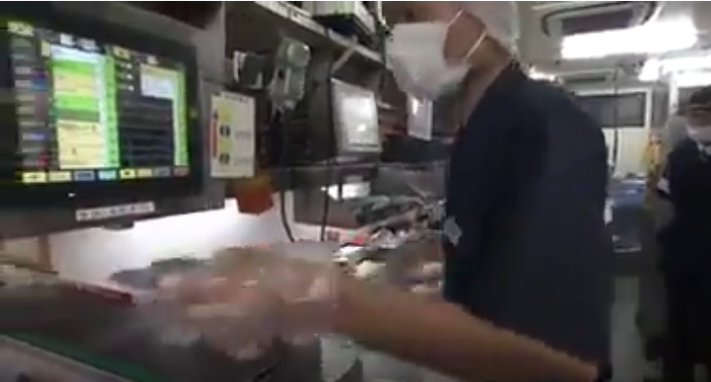
Devices :

Slide 5
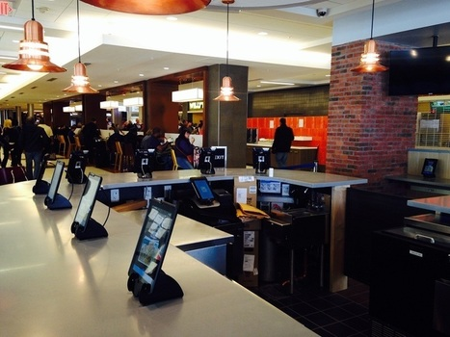
Devices :

Slide 6
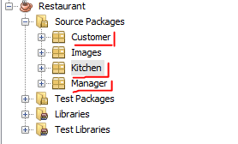
Project Structure:
3 Modules:
Customer
Kitchen
Manager
All three modules are independent and can be used independently for each type of device.

Slide 7
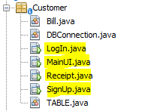
Customer Module
Contains 4 Forms:
LogIn
SignUp
MainUI
Receipt
LogIn form is the main form which will be open when a customer first sees the device.

Slide 8

Manager Module
Contains 2 Forms, 1 PopUp:
LogIn
MainUI
PopUp : Details
LogIn form is the main form which will be open when a Manager first runs the application on Computer.

Slide 9

Kitchen Module
Contains 1 Form:
MainUI
MainUI form is the main form which will be open when the application is run on device in kitchen.

Slide 10
Demonstration
Working Demo of the Project

Slide 11
Serving Food
In waiter-less restaurant, the restaurant can follow any two approaches:
Self-Service
Conveyor Belt
Images >>

Slide 12
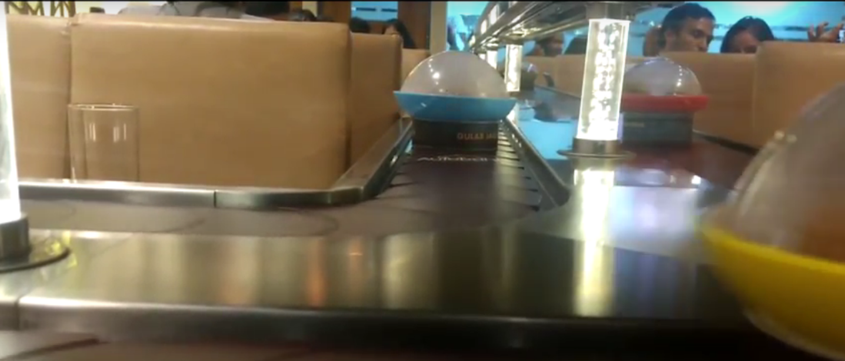
Conveyor Belt

Slide 13
THANK YOU!!
You may ask your questions please….

